Slide 1
Module 2 Wide Area Wireless Networks
Principle of Cellular Communication – Frequency Reuse concept, cluster size and system capacity, co-channel interference and signal quality; GSM – System Architecture, GSM Radio Subsystem, Frame Structure; GPRS and EDGE – System Architecture; UMTS – Network Architecture; CDMA 2000 – Network Architecture; LTE – Network Architecture; Overview of LoRa & LoRaWAN.
Self-learning Topics:- IS-95

Slide 2
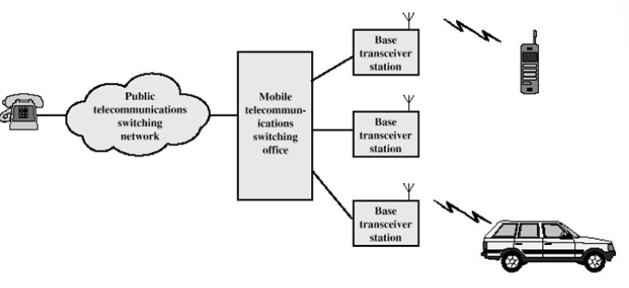
Principle of Cellular Communication
Cellular system overview

Slide 3
Principle of Cellular Communication
Cellular network is an underlying technology for mobile phones, personal communication systems, wireless networking etc.
The technology is developed for mobile radio telephone to replace high power transmitter/receiver systems.
Cellular networks use lower power, shorter range and more transmitters for data transmission.

Slide 4
Features of Cellular Systems
Offer very high capacity in a limited spectrum.
Reuse of radio channel in different cells.
Enable a fixed number of channels to serve an arbitrarily large number of users by reusing the channel throughout the coverage region.
Communication is always between mobile and base station (not directly between mobiles).
Each cellular base station is allocated a group of radio channels within a small geographic area called a cell.
Neighboring cells are assigned different channel groups.
By limiting the coverage area to within the boundary of the cell, the channel groups may be reused to cover different cells.
Keep interference levels within tolerable limits.
Frequency reuse or frequency planning.
Organization of Wireless Cellular Network.

Slide 5
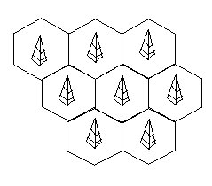
Shape of Cells
The coverage area of cellular networks are divided into cells, each cell having its own antenna for transmitting the signals. Each cell has its own frequencies. Data communication in cellular networks is served by its base station transmitter, receiver and its control unit.
The shape of cells can be either square or hexagon −
Square
A square cell has four neighbors at distance d and four at distance Root 2 d
Better if all adjacent antennas equidistant
Simplifies choosing and switching to new antenna
Hexagon
A hexagon cell shape is highly recommended for its easy
coverage and calculations.
It offers the following advantages −
Provides equidistant antennas
Distance from center to vertex equals length of side

Slide 6
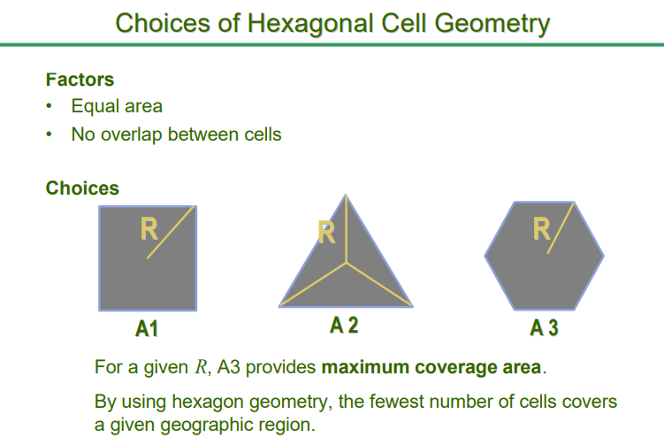

Slide 7
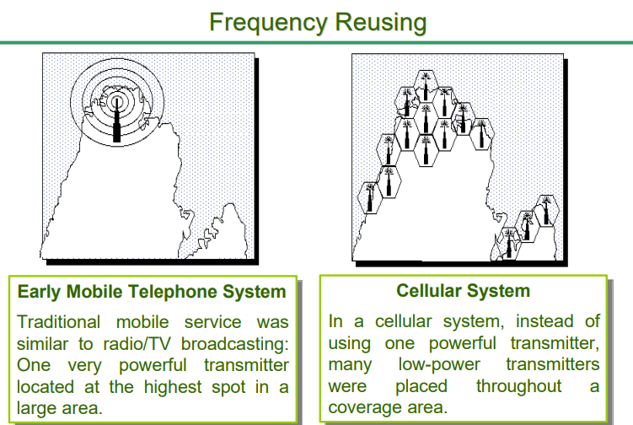

Slide 8
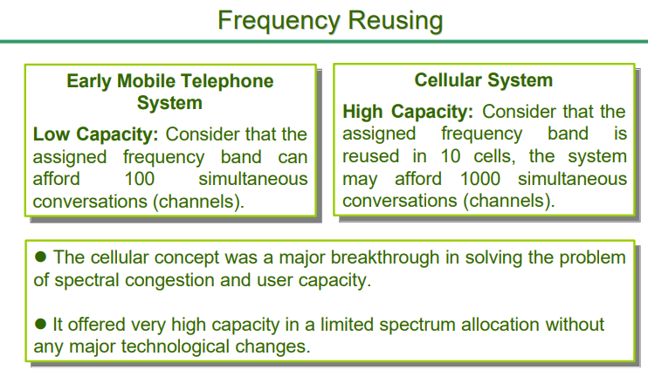

Slide 9
Frequency Reuse
Technique for using a specified range of frequencies more than once in the same radio system so that the total capacity of the system is increased without increasing its allocated bandwidth.
Frequency reuse offers the following benefits −
Allows communications within cell on a given frequency
Limits escaping power to adjacent cells
Allows re-use of frequencies in nearby cells
Uses same frequency for multiple conversations
10 to 50 frequencies per cell
For example, when N cells are using the same number of frequencies and K be the total number of frequencies used in systems. Then each cell frequency is calculated by using the formulae K/N.
In Advanced Mobile Phone Services (AMPS) when K = 395 and N = 7, then frequencies per cell on an average will be 395/7 = 56. Here, cell frequency is 56.

Slide 10
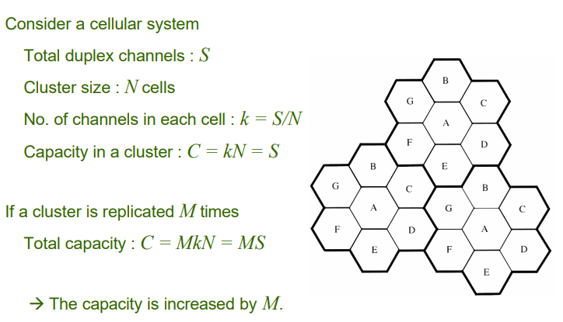

Slide 11
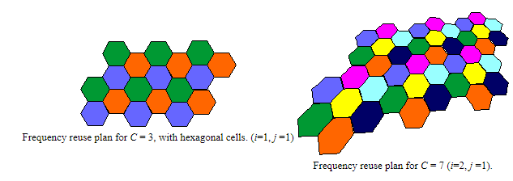
To ensure that the mutual interference between users remains below a harmful level, adjacent cells use different frequencies.
In fact, a set of C different frequencies {f₁, ..., f_{C}} are used for each cluster of C adjacent cells. Cluster patterns and the corresponding frequencies are re-used in a regular pattern over the entire service area.
The total bandwidth for the system is C times the bandwidth occupied by a single cell.

Slide 12
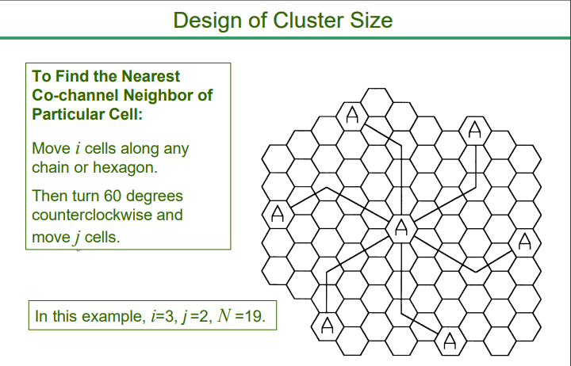

Slide 13
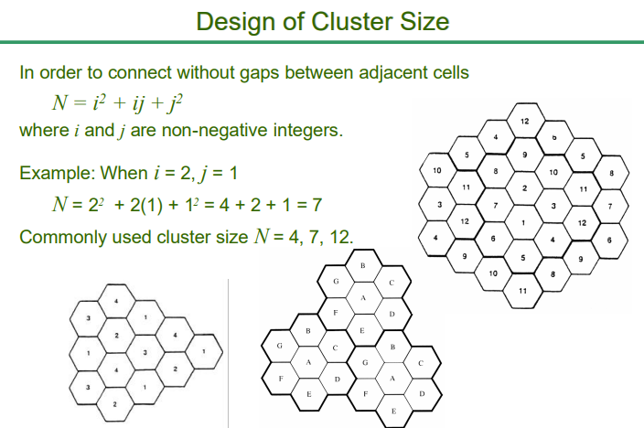

Slide 14
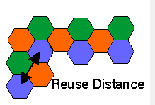
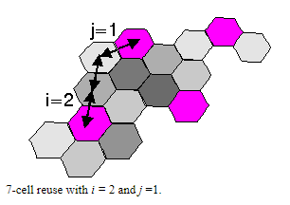
Reuse Distance (cluster design)
The closest distance between the centres of two cells using the same frequency (in different clusters) is determined by the choice of the cluster size C and the lay-out of the cell cluster.
the reuse distance r_{u}, normalized to the size of each
hexagon, is
r_{u} = SQRT{3C }
For hexagonal cells, i.e., with 'honeycomb' cell lay-outs commonly used in mobile radio, possible cluster sizes are C = i² + ij + j², with integer i and j (C = 1, 3, 4, 7, 9, ...). Integers i and j determine the relative location of co-channel cells.
Figure: Example of a reuse pattern i, j.

Slide 15
Note that the axes of coordinates i and j have a relative angle of 60 degrees. The distance between the cell centers can be expressed by invoking Pythagoras for a triangle with one angle of 60 degrees.
Moreover, we use that the distance between the centers of two neighboring cells is SQRT(3) times the size of an edge R of the hexagonal cell. This gives
r_{u} = SQRT {( i² + 2ijcos(pi/3) + j²)} SQRT{3} R.

Slide 16
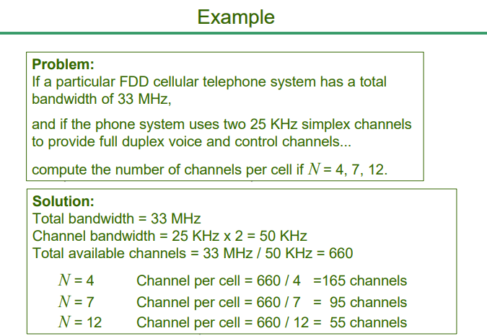

Slide 17
Co-channel interference
Sources of interference
-another mobile in the same cell,
-a call in progress in a neighboring cell,
-other base stations operating in the same frequency band,
-or any non-cellular system which inadvertently leaks energy into the cellular frequency band.
Interference on voice channels -- cross talk—loss of quality, where the subscriber hears interference in the background due to an undesired transmission.
On control channels—dropped calls, interference leads to missed and blocked calls due to errors in the digital signaling

Slide 18
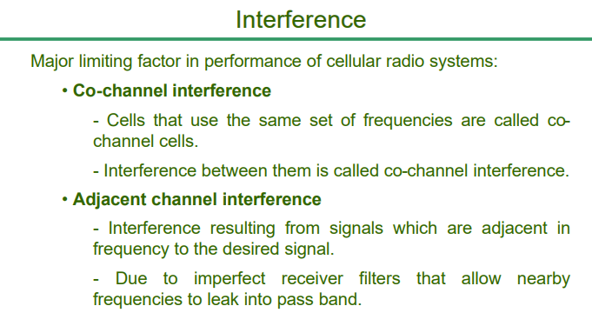

Slide 19
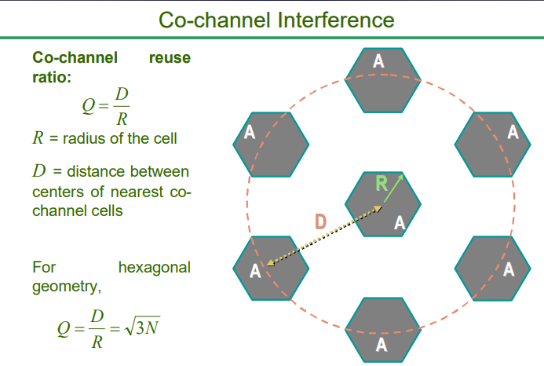
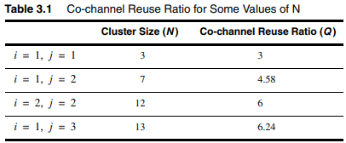
Increasing SNR does NOT solve co-channel interference (in fact, it can make it worse)
Reduce co-channel interference by increasing distance between co-channels
Small Q increases system capacity (N is small)
Small Q increases co-channel interference (less distance between cells)

Slide 20
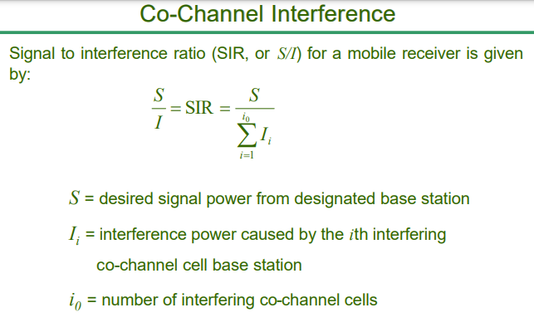

Slide 21
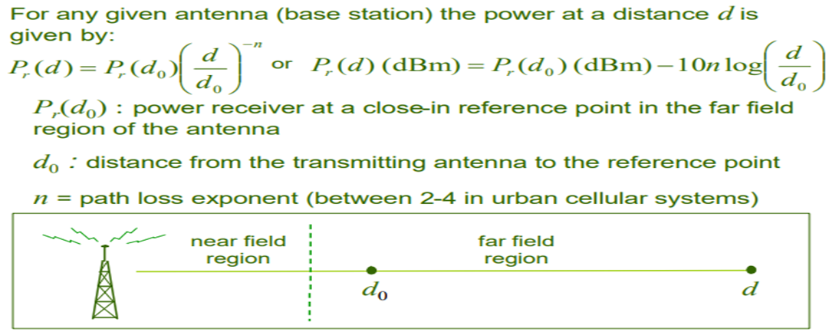
Propagation measurements in a mobile radio channel show that the average received signal strength at any point decays as a power law of the distance of separation between a transmitter and receiver. The average received power Pr at a distance d from the transmitting antenna is approximated by

Slide 22
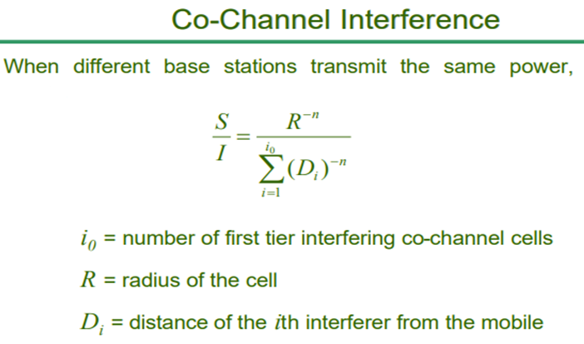
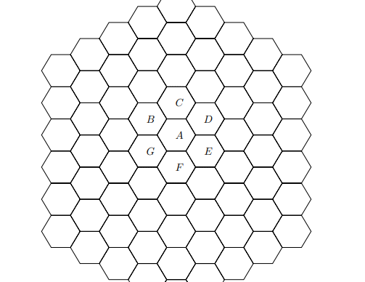
and the path loss exponent is the same throughout the coverage area, S/I for a mobile can be approximated as
Considering only the first layer of interfering cells, if all the interfering base stations are equidistant from the desired base station and if this distance is equal to the distance D between cell centers (equidistant case), then Equation (next slide) simplifies to

Slide 23
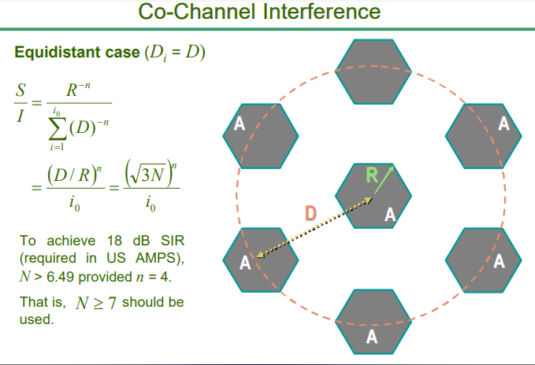
Environment | n
Free Space 2
Urban area cellular radio | 2.7 to 3.5
Shadowed urban area | 3 to 5
In building line of sight | 1.6 to 1.8
obstructed in building | 4 to 6
obstructed in factories | 2 to 3
TDMA can tolerate S/I = 15 dB

Slide 24
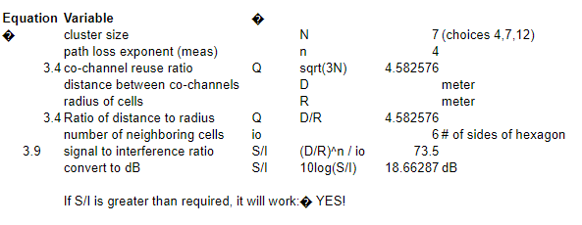

Slide 25
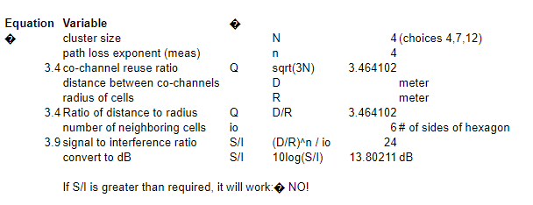

Slide 26
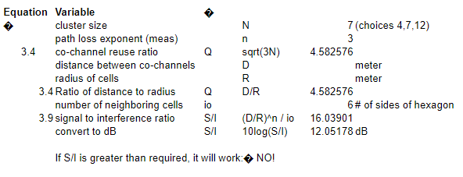

Slide 27
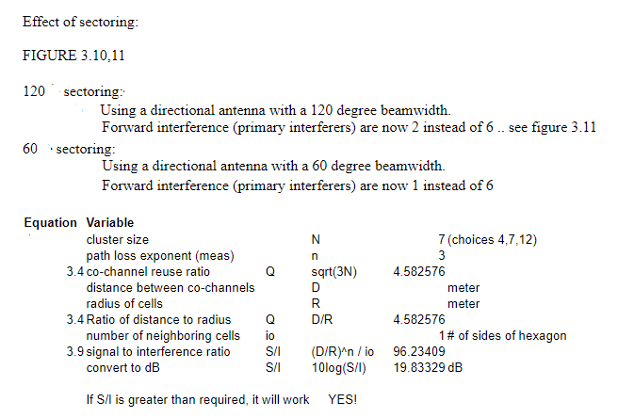
Instead of using an omnidirectional antenna at a BS, we can use several directional antenna (e.g., three 120o sectoring antenna or six 60o sectoring antenna) to cover the same cell
The total channels assigned to the cell are split among the sectors. In this way, a BS will see less number of interfering BS because of the directiveness of the antenna.

Slide 28
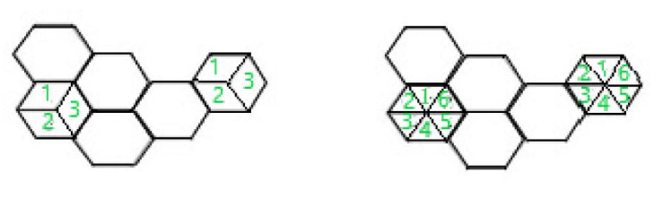

Slide 29
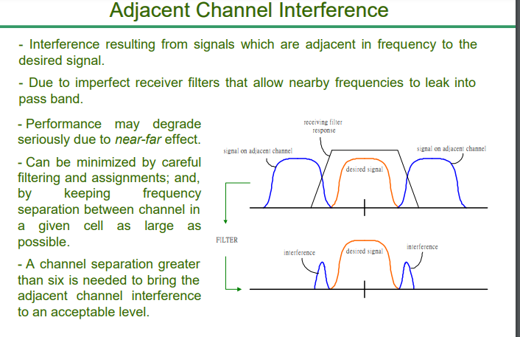

Slide 30
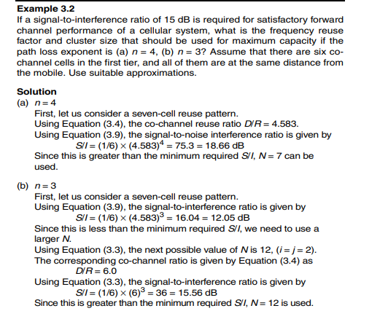

Slide 31
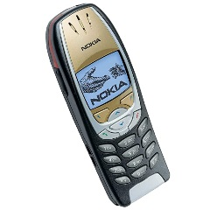
Introduction GSM
GSM (Global System for Mobile) developed by ETSI (European Technical Standards Institute) protocols for 2G.
GSM was developed to solve fragmentation problem of the 1G systems in Europe
The GSM is world’s 1st cellular system to specify digital modulation and network level architectures and services
The GSM is a circuit-switched system that divides each 200kHz channel into eight 25kHz time-slots.
GSM operates in
890MHz to 915 MHz Reverse Link (MS to BS)
935MHz to 960MHz Forward Link (BS to MS )
GSM uses FDD & a combination of TDMA & FDMA technique to provide simultaneous access to multiple mobile subscriber Units.

Slide 32
GSM is having 4 different sizes of cells are used in GSM :
Macro : In this size of cell, Base Station antenna is installed.
Micro : In this size of cell, antenna height is less than the average roof level.
Pico : Small cells’ diameter of few meters.
Umbrella : It covers the shadowed (Fill the gaps between cells) regions.
Features of GSM are :
Supports international roaming
Clear voice clarity
Ability to support multiple handheld devices.
Spectral / frequency efficiency
Low powered handheld devices.
Ease of accessing network
International ISDN compatibility.

Slide 33
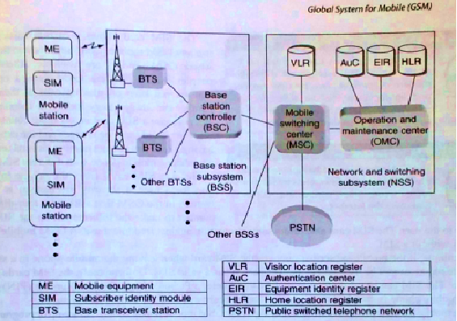
GSM Architecture

Slide 34
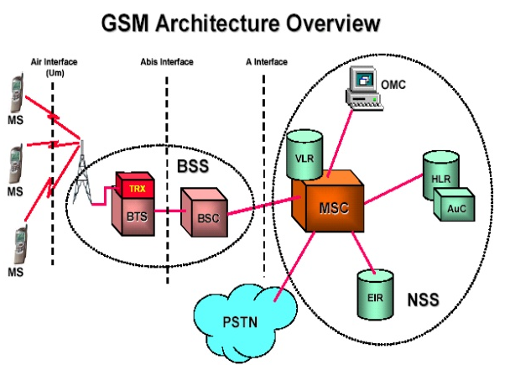

Slide 35
Mobile Station (ME & SIM)
ME-
physical device, consists of Transceiver, Digital Signal Processors and the antenna.
uniquely identified by the International Mobile Equipment Identity (IMEI).
SIM-
smart card issued at the subscription time identifying the specification of a user such as a unique number and type of the service.
The SIM card contains the International Mobile Subscriber Identity (IMSI) used to identify the subscriber to the system, a secret key for authentication, service area and other information.
The SIM card may be protected against unauthorized use by a password or personal identity number (PIN)

Slide 36
Base Station Subsystem (BSS) :(BTS & BSC)
BSC:
is the connection between the mobile station and the Mobile service Switching Center (MSC).
It is a small switch inside BSS in change of frequency administration, maintains appropriate power levels of signal and handoff among the BTSs inside a BSS. This reduces burden of MSC
BSC Controller manages the radio resources for one upto several hundred BTSs.
From 13kbps to 64kbps-at BSS

Slide 37
Base Station Subsystem (BSS) :(BTS & BSC)
Base Transceiver Station (BTS):
defines a single cell (radius 100m to 35km)
BTS components include a Tx, a Rx and signaling equipment to operate over the air interface.
Interface between BTS & BSC – Abis interface- carries traffics and maintain data
Interface between BSC & MSC – A interface- standardized within GSM.
User’s speech is converted to 13kbps digitized voice with speech coder –at MS
Wired network uses 64kbps PCM digitized voice in PSTN technology.

Slide 38
Network Subsystem
It provides link between cellular networks and PSTN or ISDN or data network.
The NSS controls handoffs between calls in different BSSs, authenticates users & validates their accounts & includes functions for enabling worldwide roaming of mobile subscriber.
It include the main switching functions of GSM as well as data based needed for subscriber data and mobility management.
It consists of
Mobile Switch Center (MSC)
Home Location Register (HLR)
Visitor Location Register (VLR)
Authentication Center (AuC)
Equipment Identity Register (EIR)
Interworking Function (IWF)

Slide 39
1. Mobile Switching Centre (MSC)
It is a hardware part of wireless switch that can communicate with PSTN using Signaling system- 7 (SS-7) protocol.
It also communicates other MSCs in the coverage area of the service provider.
Functions of MSC:
Call setup, supervision, release and Call routing
Digit collection and translation
Billing information collection
Mobility management (registration, location updating, inter BSS and inter MSC call handoffs)
Paging and alerting
Management of radio resources during call.
Echo cancellation

Slide 40
2. Home location Register (HLR)
The HLR represents a central database software that Handles the management of the mobile subscriber account.
It is referenced using the SS7 signaling capabilities for every incoming call to the GSM network for determine the current location of the subscriber.
The HLR is kept updated with the current locations of all its mobile subscribers, including those who may have roamed to other network operator within or outside the country.
The routing information is obtained from the serving VLR on a call by call basis, so that for each incoming call the HLR queries the serving VLR for an MSRN(mobile station roaming number).
Usually one HLR is deployed for each GSM network for administration of subscriber configuration and services.

Slide 41
2. Home location Register (HLR)
Besides the up to date information for each subscriber, which is dynamic, HLR maintains the following data on a permanent basis.
International Mobile Subscriber Identity (IMSI)
Service subscription information.
Service restrictions
Supplementary services subscribed to
Mobile terminal characteristics
Billing/ accounting information.
Supplementary services are additional services - include caller identification, call forwarding, call waiting, multi-party conversations, and barring of outgoing (international) calls, among others.

Slide 42
3. Visitor Location Register (VLR)
The VLR represents a temporary database software
Generally there is one VLR per MSC.
This register contains information about the mobile subscribers who are currently in the service area covered by the MSC/ VLR.
The VLR also contains information about locally activated features such as call forwarding on busy.
Thus temporary subscriber information available in VLR includes:
Features currently activated
Temporary mobile station identity (TMSI)
Current location information about the MS.

Slide 43
4. Authentication Center (AuC)
It is the database that holds different algorithms that are used for authentication & encryption of mobile subscribers that verify the mobile user’s identity
It ensure the confidentiality of each call.
AuC protects network cellular operators from different types of frauds and spoofing.
It contains the security modules for the authentication keys.
Algorithm A3 is used for authentication
Algorithm A8 is used for Cipher key generation
Algorithm A5 is used for encryption.

Slide 44
5. Equipment Identity Register (EIR)
The EIR is another database that keeps the information about identify of ME such as IMEI.
IMEI reveals the details about the manufacturer, country production and device type.
This information is used to
1. prevent calls from being misused
2. prevent unauthorized or defective MSS
3. report stolen mobile phones
4. check if the mobile is operating according to the specification of its type.
Each ME is identified by IMEI which is memorized by the manufacturer and cannot be removed.
By the registration mechanisms the MS always sends IMEI to the network so that the EIR can memories and assign them to three different lists.

Slide 45
5. Equipment Identity Register (EIR)
White list: for all known, good IMEIs- are allowed to enter in the network.
Black list: for bad or stolen handsets- are not allowed to enter in the network
Grey list: for handsets/IMEIs that are uncertain- are momentarily not allowed to enter in the network eg because of software version is too old or because they are in repair.
In future there will be an interconnections between all the EIRs to avoid the situation where a mobile stolen in one country can be used in GSM network from a different country.

Slide 46
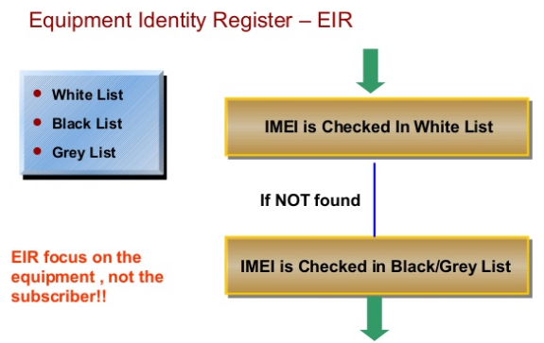

Slide 47
6. Interworking Function (IWF)
IWF-is a subsystem in the PLMN (Public Land Mobile Network)
It allows non speech communications between GSM and other networks.
The task of IWF is particularly to adopt the transmission parameters and protocol conversion.
The physical manifestation of an IWF may be through a modem which is activated by MSC dependent on bearer service and destination network.

Slide 48
7. OSS (Operation & Support System)
The implementation of OMC is called the operation and support system (OSS).
It supports operation and maintenance of systems and allows engineers to monitor, diagnose and troubleshoot every aspect of GSM network.
OSS supports one or more OMC (operation maintenance center)
Used to monitor & maintain the performance of each MS, BS, BSS and MSC within GSM system.

Slide 49
7. OSS (Operation & Support System)
OSS has main 3 functions:
To maintain all telecommunication hardware & network operations with a particular service area
Manage all ME in the system
Manage all charging and billing procedures.
Within each GSM system, an OMC is dedicated to each of these tasks and has a provision for adjusting all base station parameters and billing procedures .
It provide the ability to determine their performance and integrity of each unit of ME in the system.

Slide 50
Identifiers:
1. International Mobile Subscriber Identity (IMSI):
The IMSI is assigned to an MS at subscription time. It uniquely identifies a given MS.
When an MS attempts a call, it needs to contact a BS. The BS can offer its service only if it identifies the MS as a valid subscriber.
For this MS needs to store certain values uniquely defined for the MS, like country of subscription, network type, subscriber ID and so on.
The IMSI contains 15 digits and includes
Mobile Country Code (MCC)—3 digits (home country)
Mobile Network Code (MNC)—2 digits (Network provider Code)
Mobile Subscriber Identification code/Number (MSIC/MSIN)
National Mobile Subscriber Identity (NMSI)
Another use of IMSI is to find information about the subscriber’s home PLMN

Slide 51
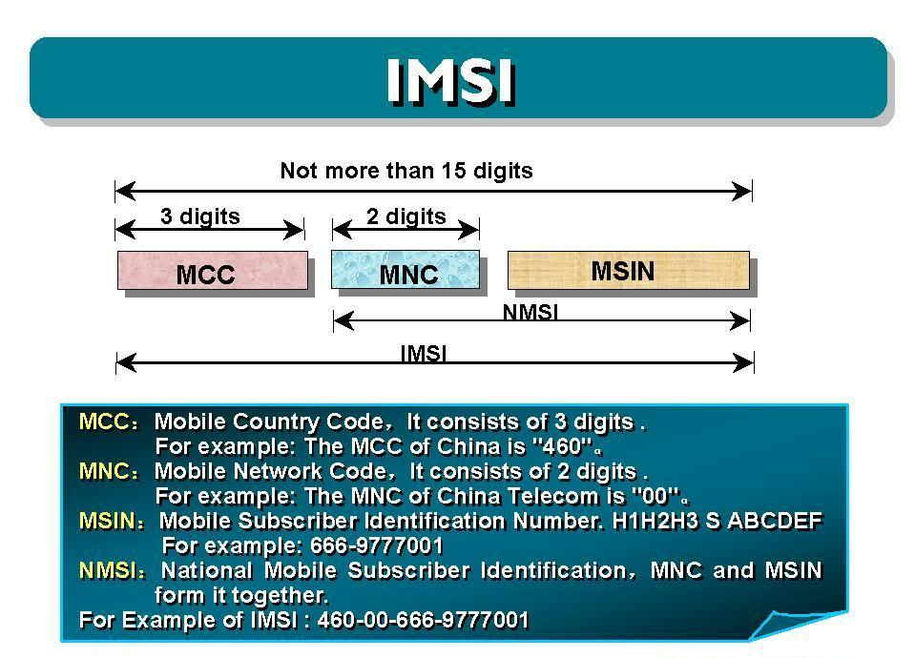
Format of IMSI
https://www.mcc-mnc.com/

Slide 52
2. SIM (Subscriber Identity Module)
Every time the MS has to communicate with a BS, it must correctly identify itself.
An MS does this by storing the mobile phone number, personal information number for mobile station, authentication parameters and so on, in the SIM card.
Smart SIM cards have a flash memory –to store small messages to the unit.
Advantage- it supports roaming with or without a cell phone, also called SIM roaming.
Carry only the SIM card alone and insert in any GSM mobile phone to make a it work as per customized MS.

Slide 53
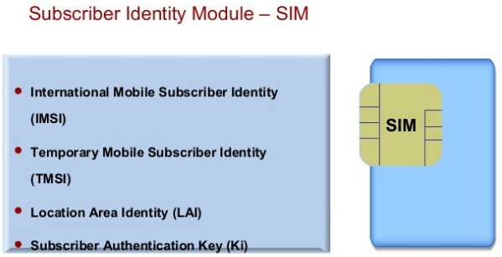

Slide 54
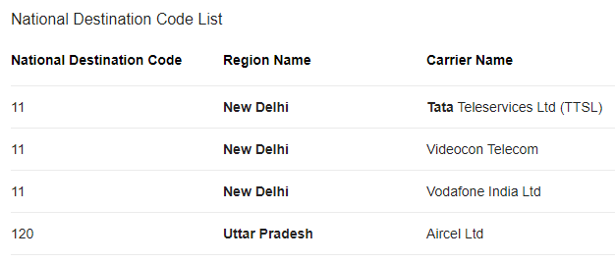
3. Mobile System ISDN (MSISDN)
It identifies a particular MS’s subscriber, with the format shown. MCC- 1 to 3 digits, NDC-variable, SN- variable
The GSM actually does not identify a particular mobile phone, but a particular HLR.It is the responsibility of HLR to contact the mobile phone.
https://ind.areacodebase.com/ndc_list

Slide 55
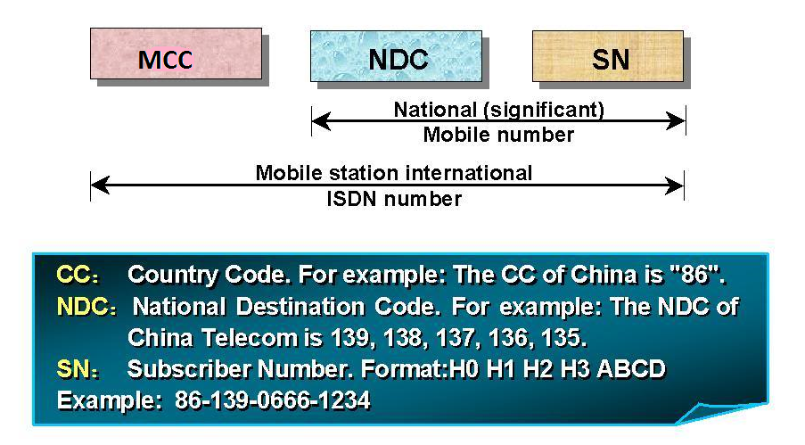
3. Mobile System ISDN (MSISDN)

Slide 56
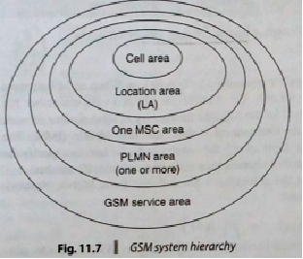
4. Location Area Identity (LAI)
GSM service area is usually divided into a hierarchical structures.
Each PLMN area is divided into many MSCs.
Each MSC typically contains a VLR to inform the system if a particular cell phone is roaming
Each MSC is divided into many location areas (LAs).
An LA is a group of cells and is useful when the MS is roaming in a different cell but the same LA.
LA identifier should contain the country code, the mobile network code and LA code.

Slide 57
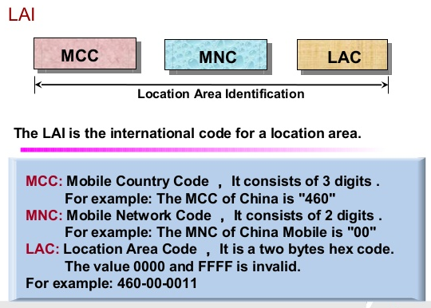

Slide 58
5. International Mobile station equipment identification (IMSEI)
Each GSM mobile phone equipment is assigned a 15-bit long international MS equipment identity number to contain manufacturing information.
When the mobile phone equipment passes the interoperability tests, it is assigned a type approval code.
Since a single mobile unit may not be manufactured at the same place, a field in IMSEI, called the final assembly code, identifies the final assembly place of the mobile unit.
To identify uniquely a unit manufactured, a Serial Number (SN) is assigned.
A spare digit is available to allow further assignment depending on requirements.

Slide 59
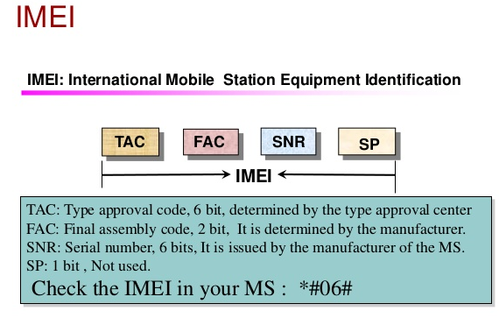

Slide 60
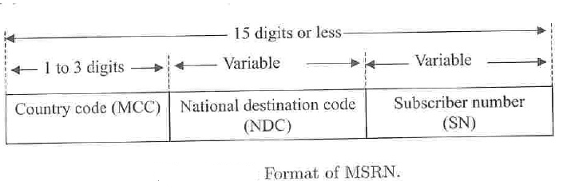
6. MS roaming Number (MSRN)
When an MS roams into another MSC, that unit has to be identified based on the numbering scheme format used in that MSC.
Hence the MS is given a temporary roaming number called MS roaming number (MSRN)
This MSRN is stored by the HLR and any calls coming to that MS are rerouted to cell where the MS is currently located

Slide 61
7. TMSI
As all transmission is sent through the air interface, there is a constant threat to security of information sent.
A Temporary identity mobile subscriber identity (TMSI) is usually sent in place of IMSEI.

Slide 62
Self reflection week 3
Students are required to go through slide no. 50 to 61 and answer the following.
1. How do you find your IMSI number on your SIM/ handset? Give format of IMSI number and Mention your own IMSI number.
2. How do you find your SIM number on handset? Mention your SIM number?
3. Give format of MSISDN number and mention the same for your handset.
4. What is LAI. Mention LAI code for India.
5.Give format for IMEI number and mention the same for your handset.
6. Give format of MSRN and give one example for the same.

Slide 63
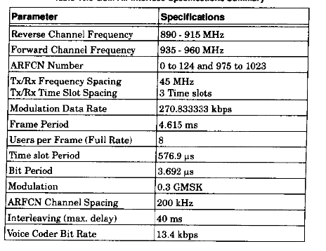
GSM Air Interface Specifications

Slide 64
GSM standard air interface specifications
Sr. No. | Parameters | Specifications
1. | Frequency Band | Uplink 890MHz-915MHz Download 935MHz-960MHz
2. | Special Allocation | 50MHz (25 MHz each for Uplink & Downlink)
3. | Forward & Reverse channel Frequency Spacing | 45 MHz
4. | Tx/Rx time slot spacing | 3 time slots
5. | RF channel BW | 200 KHz (ARFCN channel spacing)
6. | ARFCN number | 0 to 124 & 975 to 1023
7. | Multiple access technique | TDMA/FDMA
8. | Duplexing Technique | FDD
9. | Modulation scheme | GMSK (B* Tb = 0.3)
10. | No. of time slots per RF channel BW | 8 (users per frame full rate)
11. | No of voice channels | 1000

Slide 65
GSM standard air interface specifications
Sr. No. | Parameters | Specifications
12. | Modulation data rate | 270.833 kbps
13. | Spectrum efficiency | 1.35bps/Hz
14. | Frame period | 4.615ms
15. | Time slot period | 577 us
16. | Bit period | 3.692 us
17. | Interleaving (max delay) | 40 ms
18. | Speech coding | RELP-LTP @ 13.4 kbps
19. | Channel Coding | CRC with r = ½; L=5 convolution coding
20. | Type of equalizers | Adaptive
21. | Handheld mobile Tx power | 1 W max; 125mW avg

Slide 66
GSM Radio Subsystem
As suggested by the name, the radio subsystem is comprised of all the radio specific elements, i.e.
The mobile stations (MS) and the base station subsystem (BSS).
The connection between the RSS and the NSS via the A interface (solid lines) and
The connection to the OSS via the O interface (dashed lines).
The A interface is generally based on a circuit-switched PCM-30 system (2.048 Mbit/s), carrying up to 30 X 64 kbit/s connections, whereas the O interface uses the Signalling System No. 7 (SS7) based on X.25 carrying system management data to/from the RSS.

Slide 67
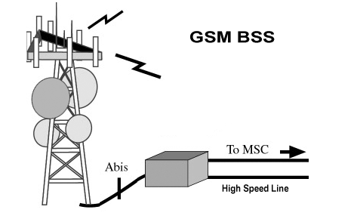
Base station subsystem( BSS)
The BSS is composed of two parts:
The Base Transceiver Station (BTS)
The Base Station Controller (BSC)
The BTS and the BSC communicate across the specified Abis interface, enabling operations between components that are made by different suppliers.
The radio components of a BSS may consist of four to seven or nine cells. A BSS may have one or more base stations.
The BSS uses the Abis interface between the BTS and the BSC.
A separate high-speed line (T1 or E1) is then connected from the BSS to the Mobile MSC.

Slide 68
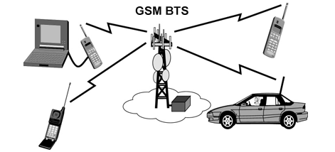
The Base Transceiver Station (BTS)
The BTS corresponds to the transceivers and antennas used in each cell of the network. A BTS is usually placed in the center of a cell. Its transmitting power defines the size of a cell. Each BTS has between 1 and 16 transceivers, depending on the density of users in the cell. Each BTS serves as a single cell. It also includes the following functions:
Encoding, encrypting, multiplexing, modulating, and feeding the RF signals to the antenna
Transcoding and rate adaptation
Time and frequency synchronizing
Voice through full- or half-rate services
Decoding, decrypting, and equalizing received signals
Random access detection
Timing advances
Uplink channel measurements

Slide 69

GSM channels
Uplink Frequency = 890MHz- 915 MHz (Forward)
Downlink Frequency = 935 MHz- 960 MHz (Reverse)
The available 25 MHz spectrum is divided into 124 FDM channels
Each occupy 200 KHz with 100 KHz guard band at two edges of the spectrum.
The available Forward & reverse frequency bands are divided into 200 KHz wide channels called ARFCN (Absolute Radio Frequency Channel Numbers)

Slide 70
Frame structure Designing Requirements:
Frequency Band of Operation: around 900MHz
Number of Logical Channels or Number of Time slots in TDMA frames: 8 frames to serve 8 simultaneous users
Channel Bandwidth: 25 KHz . To serve 8 mobile subscribers using TDMA, Channel BW= 8*25= 200 KHz
Maximum Cell Radius (R): max 35km
Maximum Vehicle Speed (Vm): 250km/h
Maximum Delay Spread (∆m): 10 sec
Maximum Coding Delay: 20ms

Slide 71
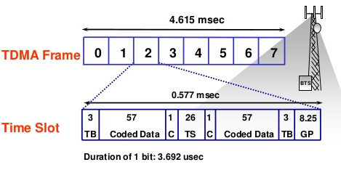
GSM basic Frame structure
TB :Trail Bits:3 bits at the start and at the end excluding Guard bits
Coded/Encrypted Data : two 57 bits data fields i.e.114 cipher text bits
Stealing Bit : 1 bit each at the end of two 57 bit data field. It indicate whether this block contains data or stolen (for urgent control signaling)
Training Data : 26 bits, known bit pattern that differs for different adjacent cells. Used for multipath equalization to extract the desired signal from unwanted reflections.
Guard Bits: 8.25 bits, used to avoid overlapping with other bursts due to different path delays.

Slide 72
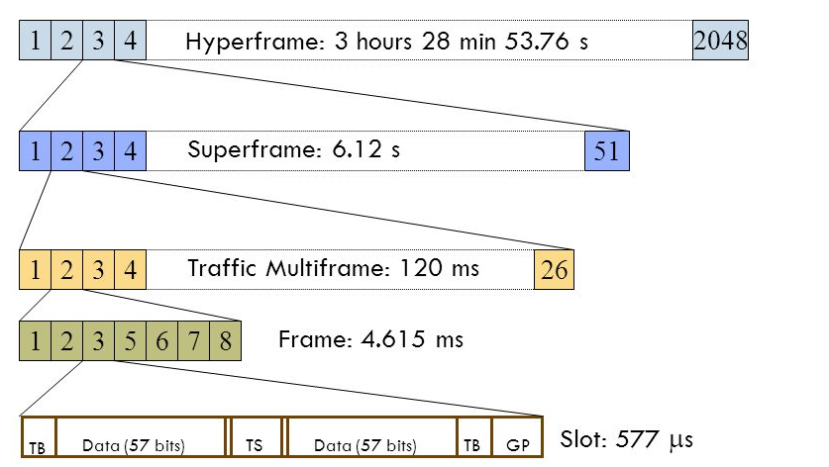
GSM Hyperframe format

Slide 73
GPRS Technology
The General Packet Radio Service (GPRS) is non voice value added service to the mobile users
It is an enhancement of GSM system – uses packet switched data services
Well suited for non real time internet usage such as retrieval of emails, Faxes & Asymmetric web browsing (where downloading is more than uploading)
It requires some new network elements, interfaces and protocols that handles packet traffic
It provides short connection set up times
practical data rates up to 115 kbps for each mobile data user.

Slide 74
Key Features of GPRS
Packet switching: information data is split into separate packets before transmission and reception.
Mobile data over GPRS network : it uses the air interface and infrastructure of GSM network that can support up to 171.2kbps
Spectrum efficiency : GPRS resources are used only when mobile users are actually sending or receiving data (instead of a dedicated channel).
This enhances the spectrum efficiency as many GPRS users can potentially share the same BW and be served together.

Slide 75
Key Features of GPRS
d) Capacity Enhancement: Because of high spectrum efficiency it may not be required to build idle capacity for use during peak hours, and allow using network resources in a dynamic and flexible way.
GPRS reduces SMS center and signaling channel loading by migrating some traffic using GPRS/SMS interconnect supported by the GPRS network.
Reservation Protocol in GPRS: the raw data rate (high)=171.2kbps . The same slot can be reserved for data access using slotted ALOHA reservation protocol medium access technique.
Security Features: includes key security parameters such as anonymity, authentication and confidentiality for user data and signaling. Same as GSM.

Slide 76
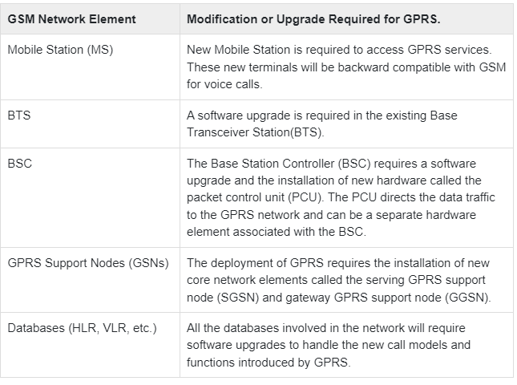

Slide 77
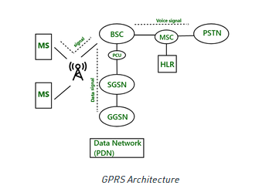
GPRS Architecture
In GPRS there is one component is added to BSC called PCU.
PCU stands for Packet Control Unit. If signal comes to BSC and that signal contains data, then PCU routes to the SGSN.
Interface is used between BSC and PCU is FRI interface.
After signal comes to SGSN, it delivers the data packet to the GGSN.
GGSN routes the data packet to the data network (PDN- Predefined Data Network).

Slide 78
GPRS architecture
New network elements:
GGSN(Gateway GPRS Support Node)
SGSN(Serving GPRS Support Node)
Other elements
GPRS backbones
GPRS Mobile classes

Slide 79
GPRS Network Architecture
Technical changes to make GPRS from GSM:
GPRS-MS:
new GPRS enabled mobile subscriber phones are required
These phones are backward compatible with GSM
Three types of GPRS Mobile phones
A) Class A : support simultaneous GPRS services and GSM services such as voice and SMS. This support include simultaneous attach, activation, monitor and traffic.
B) Class B : support either GSM or GPRS at a time (it can monitor channels of both GSM and GPRS). This support simultaneous attach, activation, monitor but not simultaneous traffic.
C) Class C: supports only GPRS services. It supports only non-simultaneous attach.

Slide 80
Serving GPRS Support Node (SGSN)
analogous to MSC (in GSM)
deliver packets to the MSs within its service area.
send queries to HLRs to obtain profile data of GPRS subscribers.
detects new GPRS MSs, process its registration & keep record of their location.
Main Function :
to handle authentication,
data compression,
ciphering and
mobility management .

Slide 81
Gateway GPRS Support Node (GGSN)
Mediator between GPRS backbone and external data networks.
Saves current data for the SGSN address of the participant as well as their profile and data for authentication and invoice.
Main functions
Interface to external data networks
Resembles to a data network router
Forwards end user data to right SGSN
Routes mobile originated packets to right destination
Filters end user traffic
Collects charging information for data network usage
Data packets are not sent to MS unless the user has activated the PDUs (Protocol Data Units) address

Slide 82
Other elements
BG (Border Gateway): (Not defined within GPRS)
Routes packets from SGSN/GGSN of one operator to a SGSN/GGSN of an other operator
Provides protection against intruders from external networks
DNS (Domain Name Server)
Translates addresses from ggsn1.oper1.fi -format to 123.45.67.89 format (i.e. as used in Internet)
Charging Gateway
Collects charging information from SGSNs and GGSNs
PTM-SC (Point to Multipoint -Service Center)
PTM Multicast (PTM-M): Downlink broadcast; no subscription; no ciphering
PTM Group call (PTM-G): Closed or open groups; Down/up -link; ciphered
Geographical area limitation

Slide 83
GPRS backbones
Enables communication between GPRS Support Nodes
Based on private IP network
IPv6 is the ultimate protocol
IPV4 can be used as an intermediate solution
Intra-PLMN backbone (The PLMN is the term used to describe all mobile wireless networks that use earth-based stations rather than satellites.)
Connects GPRS Support Nodes of one operator
Operator decides the network architecture
LAN, point-to-point links, ATM, ISDN, ...
Inter-PLMN backbone
Connects GPRS operators via BGs (Border Gateways)
Provides international GPRS roaming
Operators decide the backbone in the roaming agreement

Slide 84
Mobility management
Instead of Location Area, GPRS uses Routing Areas to group cells.
RA is a subset of LA.
Location management depends on three mobile states:
IDLE: MS is not known by the network (SGSN) (not reachable)
STANDBY: MS’s location is known in accuracy of Routing Area
MS must inform its location after every Routing Area change (no need to inform if MS changes from one cell to another within same RA)
READY: MS’s location is known in accuracy of cell (the SGSN knows the cell location of the MS.)
MS must inform its location after every cell change
SGSN does not need to page the MS before data transfer
MS listens continuously GPRS BCCCH channel

Slide 85
GPRS Services
Typical GPRS applications include all normal GSM services but in efficient and faster way. It also supports services like e-mail and web browsing format language.
It also supports new set of services such as enhanced short messages, wireless imaging with instant pictures, video services, document and information sharing.
Benefits available for service providers include efficient use of radio spectrum resources, fast and flexible implementation with GSM coverage, low investment cost.
The benefits offered to mobile data users include wide area coverage, fast access time, higher speed, high level security.

Slide 86
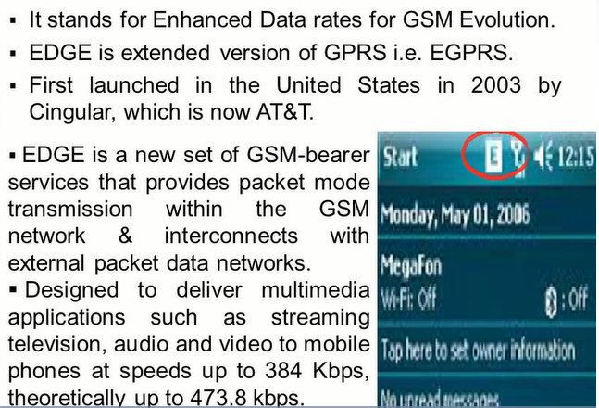
EDGE Technology

Slide 87
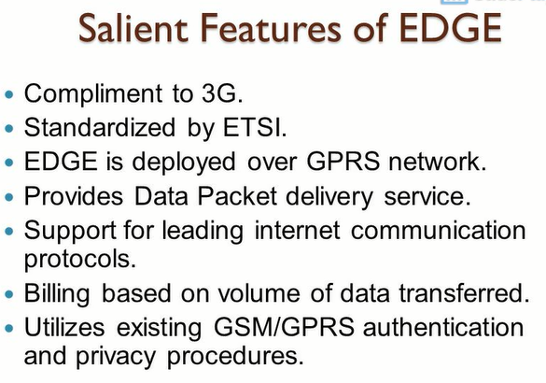

Slide 88
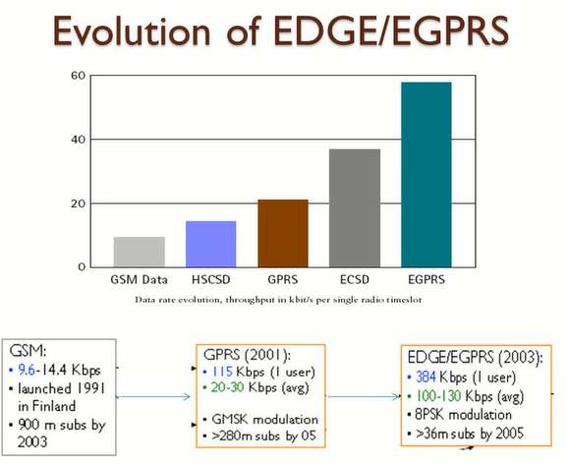

Slide 89
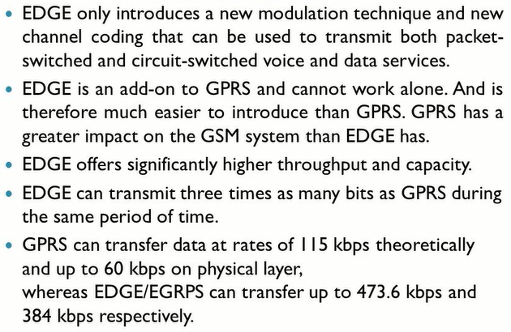
GPRS vs EDGE

Slide 90


Slide 91


Slide 92

Modulation and Coding Schemes(MCS)

Slide 93
EDGE Technology
Base station: Apart from the upgrade to incorporate the 8PSK modulation capability, other small changes are required to the base station. These are normally relatively small and can often be accomplished by software upgrades.
Mobile stations: It is necessary to have a GSM EDGE handset that is EDGE compatible. As it is not possible to upgrade handsets, this means that the user needs to buy a new GSM EDGE handset.

Slide 94
EDGE Technology
Upgrade to network architecture: GSM EDGE provides the capability for IP based data transfer. As a result, additional network elements are required.
Gateway GPRS Service Node (GGSN)
Serving GPRS Service Node (SGSN)
Packet Control Unit (PCU)

Slide 95
EDGE Technology
GSM EDGE network architecture upgrades
Gateway GPRS Service Node (GGSN) : The GGSN connects to packet-switched networks such as the Internet and other GPRS networks. It forms the gateway to the outside world.
Serving GPRS Service Node (SGSN):The SGSN provides the packet-switched link to mobile stations. This forms a gateway to the services within the network.
Packet Control Unit(PCU): which differentiates whether data is to be routed to the packet switched or circuit switched networks

Slide 96
EDGE Technology
SGSN (Serving GPRS Service Node): It provides a variety of services to the mobiles:
Packet routing and transfer
Mobility management
Authentication
Attach/detach
Logical link management
Charging data
There is a location register within the SGSN and this stores location information (e.g., current cell, current VLR). It also stores the user profiles (e.g., IMSI, packet addresses used) for all the GPRS users registered with the particular SGSN.

Slide 97
EDGE Technology
GGSN (Gateway GPRS Service Node )
The GGSN organizes the inter-working between the GPRS / EDGE network and external packet switched networks to which the mobiles may be connected. These may include both Internet and X.25 networks.
The GGSN can be considered to be a combination of a gateway, router and firewall as it hides the internal network to the outside.
When the GGSN receives data addressed to a specific user, it checks if the user is active, then forwarding the data. In the opposite direction, packet data from the mobile is routed to the right destination network by the GGSN.

Slide 98
EDGE Technology
PCU (Packet Control Unit )
It is a hardware router that is added to the BSC.
It differentiates data destined for the standard GSM network (circuit switched data) and data destined for the EDGE network (Packet Switched Data).
The PCU itself may be a separate physical entity, or more often these days it is incorporated into the base station controller, BSC, thereby saving additional hardware costs.

Slide 99
What EDGE Would Mean to Subscribers
Streaming applications
Very high speed downloads
Corporate intranet connections
Quicker MMS
Video phone
Vertical corporate applications - Video conference, Remote presentations.

Slide 100
GSM EDGE evolution specification overview
Parameter | Details
Multiple Access Technology | FDMA / TDMA
Duplex Technique | FDD
Channel Spacing | 200 kHz
Modulation | GMSK, 8PSK
Slots per channel | 8
Frame duration | 4.615 ms
Latency | Below 100 ms
Overall symbol rate | 270 k symbols / s
Overall modulation bit rate | 810 kbps
Radio data rate per time slot | 69.2 kbps
Max user data rate per time slot | 59.2 kbps (MCS-9)
Max user data rate when using 8 time slots | 473.6 kbps **

Slide 101


Slide 102
Universal Mobile Terrestrial Telecommunication Systems (UMTS)
Is the standard for delivering 3G services based on GSM.
Global Wireless standard
UMTS includes all aspects of the system, including
Physical layer
Network planning
Architecture & protocols
Services & applications
Objectives: to integrate all forms of mobile communication
It provides up to 2Mbps in local area &
less than 1Mbps in wide area access with full mobility

Slide 103


Slide 104

Frequency Allocations for UMTS
Frequency Bands Uplink: 1885 MHz-2035MHz &
Downlink : 2110 MHz-2200MHz
High frequency spectrum efficiency.

Slide 105

UMTS Network Architecture

Slide 106
UMTS Network Architecture
Partly based on 2G with some new components
The MS of GSM=User Equipment (UE) in UMTS-additional functionality
MSC has same function in GSM and UMTS
SGSN: supports up to 2Mbps
Iu interface: connects the core network element to radio network similar to ‘A-interface’ in GSM
Major changes:
Radio Access Network (RAN) also called UMTS terrestrial RAN (UTRAN)
Iur interface : connects 2 neighboring Radio Network Controllers (RNCs)
Iub interface : connects BSs to RNC

Slide 107

UTRAN Architecture
RNS : Radio Network Subsystems , is responsible for Radio resources and transmission/reception in a set of cells.
Iub = RNC to BSs , Node B= BTS

Slide 108


UTRAN Architecture
RNS has main two elements : 1) Node B 2) RNC
1. Radio Network Controller (RNC):
Functions:
Radio resource management
Serving RNS relocation
Frame synchronization
Macro diversity combining
Intra-UTRAN handoff
Splitting of the I_{ub} data streams
Outer loop power control
RLC sublayers function execution
Functions equivalent to BSC in GSM
RNCs can manage handovers without using MSC and SGSN
2. Node B
equivalent to BTS
physically co-located with GSM BTS to reduce the cost

Slide 109
UMTS interfaces
1.Uu –between UE and network, air interface ‘Um’ In GSM
2. Iu-CS-circuit switched connection for carrying voice traffic and signaling between the UTRAN and core network
‘A’ interface in GSM
3. Iub- used by RNC to control multiple Node Bs
‘A-bis’ interface in GSM/GPRS
4. Iu-PS packet switched connection for data traffic and signaling between the UTRAN and core data GPRS network,
Gb inteface in GSM/GPRS
5. Iur-to support inter MSC mobility.
When a mobile user moves between areas served by diff RNCs mobile subscriber data is transferred to new RNC via Iur.
original RNC-serving RNC new RNC-drift RNC

Slide 110


UMTS Air Interface Specifications
WCDMA – is radio interface technology in UMTS network, CH BW-5 MHz
The UMTS air interface is based on DS-CDMA (direct sequence CDMA)
Spreading Factor – ration of chip rate to data rate

Slide 111

UMTS
User Equipment: new name - considerably greater functionality that the UE could have. It could also be anything between a mobile phone to a data terminal attached to a computer with no voice capability.
UE RF circuitry, Baseband processing, Battery, USIM
3G UMTS Radio Network Subsystem- UMTS Radio access network-UTRAN: interfaces to both the UE and the core network.
3G UMTS Core Network: Additional functionality –split in to two different areas: 1) circuit switched elements and 2) packet switched elements

Slide 112
Circuit switched elements:
primarily based on the GSM network entities and carry data in a circuit switched manner, i.e. a permanent channel for the duration of the call.
It is used to provide voice and CS data services.
It contains Mobile Switching Center (MSC) and Gateway MSC(GMSC) as functional entities.
Packet switched elements:
to carry packet data.
• It is used to provide packet based services.
It contains Serving GPRS support node (SGSN),
Gateway GPRS support node (GGSN),
Domain Name Server (DNS),
Dynamic Host Configuration Protocol (DHCP) server,
packet charging gateway, and firewalls.

Slide 113
The core network can be split into the following different functional areas:
Functional entities needed to support PS services (e.g.3G-SGSN, 3G- GGSN)
Functional entities needed to support CS services (e.g. 3G-MSC/VLR)
Functional entities common to both types of services (e.g. 3G-HLR)
Other areas that can be considered part of the core network include:
Network management systems (billing and provisioning, service management, element management, etc.)
IN system (service control point (SCP), service signaling point (SSP), etc.)
ATM/SDH/IP switch/transport infrastructure.
Some network elements: associated with registration are shared by both domains and operate in the same way that they did with GSM.

Slide 114

Circuit switched elements Mobile switching centre (MSC): This was essentially the same as that within GSM, and it managed the circuit switched calls under way. Gateway MSC (GMSC): This was effectively the interface to the external networks.

Slide 115
Packet switched elements
Serving GPRS Support Node (SGSN):
The SGSN provided a number of functions within the UMTS network architecture.
Mobility management When a UE attached to the Packet Switched domain of the UMTS Core Network, the SGSN generates MM information based on the mobile's current location.
Session management: The SGSN managed the data sessions providing the required quality of service and it also managed what were termed the PDP (Packet data Protocol) contexts, i.e. the pipes over which the data was sent.
Interaction with other areas of the network: The SGSN was able to manage its elements within the network only by communicating with other areas of the network, e.g. MSC and other circuit switched areas.
Billing: The SGSN was also responsible billing. It achieved this by monitoring the flow of user data across the GPRS network. CDRs (Call Detail Records) were generated by the SGSN before being transferred to the charging entities (Charging Gateway Function, CGF).

Slide 116
Gateway GPRS Support Node (GGSN):
GGSN was the central element within the UMTS packet switched network.
It handled inter-working between the UMTS packet switched network and external packet switched networks, and could be considered as a very sophisticated router.
In operation, when the GGSN received data addressed to a specific user, it checked if the user was active and then forwarded the data to the SGSN serving the particular UE.

Slide 117


Slide 118

CDMA2000 Cellular Technology
Cdma 2000-1xMC (Multi-carrier)
3G CDMA Evolution Path
RTT: Radio transmission Technology
EV: Evolutionary advancement, DV: data & voice DO: Data only

Slide 119

Interim Standard 95 (IS-95)
Interim Standard 95 (IS-95) was the first ever CDMA-based digital cellular technology. It was developed by Qualcomm and later adopted as a standard TIA/EIA/IS-95 release published in 1995.
Also known as IS-95A.The proprietary name for IS-95 is cdmaOne.
It is a 2G mobile telecommunications standard that uses CDMA.
In 1999, IS-95B added a 64 Kbps packet capability, enabling data to be transmitted to a CDMA cell phone.

Slide 120


Slide 121

Cdma2000 Technical Specifications

Slide 122
Key Features of CDMA2000
Leading performance in terms of data-speeds, voice capacity and latencies
Efficient use of spectrum
Support for advanced mobile services
Compatible with IP
Broadest selection of mobile devices
Seamless evolution path
Flexibility

Slide 123



Slide 124


Slide 125


Slide 126


Slide 127
CDMA Technology
Advantages of CDMA Cellular System
Frequency diversity -frequency dependent transmission impairments have less effect on signal
Multipath resistance -chipping codes used for CDMA exhibit low cross correlation and low autocorrelation
Privacy -privacy is inherent since spread spectrum is obtained by use of noise-like signals
Gradual degradation -system only gradually degrades as more users access the system
CDMA uses larger bandwidth but utilizing resulting processing gain to enhance capacity.
Efficient practical utilization of the fixed frequency spectrum
Flexible allocation of resources-larger numbers of phones can be served by smaller numbers of cell-sites
CDMA superior over TDMA in terms of capacity ,cost and speech quality.

Slide 128
CDMA Technology
Drawbacks of CDMA Cellular
Self-jamming – arriving transmissions from multiple users not aligned on chip boundaries unless users are perfectly synchronized
Near-far problem – signals closer to the receiver are received with less attenuation than signals farther away
Soft handoff – requires that the mobile acquires the new cell before it relinquishes the old; this is more complex than hard handoff used in FDMA and TDMA schemes
Air-interface is the most complex
Not symmetrical (unlike TDMA):Forward and reverse channels are different. Forward channel uses orthogonal spreading codes. Reverse channel transmissions are not synchronized

Slide 129


3GPP Long Term Evolution(LTE)

Slide 130

Introduction
In Nov. 2004, 3GPP (3rd Generation Partnership Project) began a project to define the Long-Term Evolution (LTE) of Universal Mobile Telecommunications System (UMTS) cellular technology.
LTE is a standard for wireless data communications technology and an evolution of the GSM/UMTS standards.
The goal of LTE was to increase the capacity and speed of wireless data networks using new DSP (digital signal processing) techniques and modulations.
A further goal was the redesign and simplification of the network architecture to an IP-based system with significantly reduced transfer latency compared to the 3G architecture.

Slide 131

Why cellular industry wants to move to new standard ?
Need for improved data rates and spectral efficiency in particular in dense urban environments,
For some operators, the possibility to “leapfrog” from 2G directly to 4G technology,
The competition from WiMAX
The possibility of acquiring new spectrum in the name of getting it for a new system.

Slide 132
Goals of LTE
Category | Goal | communication
Peak Data Rate | 100 Mbit/s | downlink
 | 50 Mbit/s | Uplink
spectrum allocation | 20-MHz | Downlink
 | 20-MHz | Uplink
spectral efficiency | 5 bit/s/Hz | downlink
 | 2.5 bit/s/Hz | Uplink

Slide 133

Goals of LTE
LTE defines a number of different types of Mobile Stations (MSs) that present a tradeoff between complexity and performance

Slide 134
Goals of LTE
For latency, the goals distinguish between
1. Control-plane latency is defined as the time for a handset to transition from various nonactive states to active states, which are between 50 and 100 ms, depending on the state in which the MS originally was. At least 400 active MSs per cell should be supported.
2. User-plane latency is defined as the time it takes to transmit a small Internet Protocol (IP) packet to the edge node of the Radio Access Network, RAN, which should not exceed 5ms in a network with a single MS (i.e., no congestion problems).

Slide 135
Goals of LTE
Generally, user throughput should improve 2–4 times compared to previous technology.
The system is intended to be optimized for:
Low speeds (0–15 km/h), since the main usage, especially for data services.
Slight performance degeneration is allowed for speeds up to 120 km/h,
Truly high-speed applications (up to 500 km/h), only basic connectivity needs to be retained.

Slide 136
Goals of LTE
The transition from WCDMA/HSPA(High Speed Packet Access) (including legacy Global System for Mobile communication (GSM) systems) to LTE should be made as seamless as possible.
Transitions from one system to another will be frequently required, especially during the initial rollout of LTE, when only parts of the country will be covered by LTE Base Stations (BSs).
Transition times for real-time applications should be less than 300 ms, and for non real-time applications should be 500 ms

Slide 137
Frequency Bands and Spectrum Flexibility
LTE can be operated in a variety of frequency bands
This spectrum can be used for any member of the IMT-2000 and IMT-Advanced family.
Bands | Frequencies/application | Used by country
3, 8 | Migration from GSM to LTE | Europe
2, 4, 10 | PCS frequencies | USA
5 | Lower frequency operation | USA
6. 9 | Traditional Japanese operator | Japan
12, 13, 14, 17 | Auctioned off | USA

Slide 138


Slide 139


Slide 140
LTE Architecture
The high-level network architecture of LTE is comprised of following three main components:
The User Equipment (UE).
The Evolved UMTS Terrestrial Radio Access Network (E-UTRAN).
The Evolved Packet Core (EPC).

Slide 141


Slide 142

A USIM stores user-specific data very similar to 3G SIM card. This keeps information about the user's phone number, home network identity and security keys etc.

Slide 143


Slide 144


Slide 145
Each eBN connects with the EPC by means of the S1 interface and it can also be connected to nearby base stations by the X2 interface, which is mainly used for signalling and packet forwarding during handover.
A home eNB (HeNB) is a base station that has been purchased by a user to provide femtocell coverage within the home.
A home eNB belongs to a closed subscriber group (CSG) and can only be accessed by mobiles with a USIM that also belongs to the closed subscriber group.

Slide 146


The Evolved Packet Core (EPC) (The core network)
There are few more components which have not been shown in the diagram to keep it simple. These components are like the Earthquake and Tsunami Warning System (ETWS), the Equipment Identity Register (EIR) and Policy Control and Charging Rules Function (PCRF).

Slide 147
The Home Subscriber Server (HSS) component has been carried forward from UMTS and GSM and is a central database that contains information about all the network operator's subscribers.
The Packet Data Network (PDN) Gateway (P-GW) communicates with the outside world ie. packet data networks PDN, using SGi interface. Each packet data network is identified by an access point name (APN). The PDN gateway has the same role as the GPRS support node (GGSN) and the serving GPRS support node (SGSN) with UMTS and GSM.

Slide 148
The serving gateway (S-GW) acts as a router, and forwards data between the base station and the PDN gateway.
The mobility management entity (MME) controls the high-level operation of the mobile by means of signalling messages and Home Subscriber Server (HSS).
The Policy Control and Charging Rules Function (PCRF) is a component which is not shown in the above diagram but it is responsible for policy control decision-making, as well as for controlling the flow-based charging functionalities in the Policy Control Enforcement Function (PCEF), which resides in the P-GW.

Slide 149
The interface between the serving and PDN gateways is known as S5/S8. This has two slightly different implementations, namely S5 if the two devices are in the same network, and S8 if they are in different networks.

Slide 150

Functional split between the E-UTRAN and the EPC

Slide 151

Overview of LoRa & LoRaWAN

Slide 152
Communication is one of the most important parts of any IoT project. The ability of a thing to communicate with other “things” (a device cloud/server) is what gives the “thing” the right to attach the “internet” to its name. While tons of communication protocols exist, each of them lacks one thing or the other which made them “not totally suitable” for IoT applications. The Major problems being power consumption, range/coverage and bandwidth.
Most communication radios like Zigbee, BLE, WiFi among others are of short range and others like, 3G and LTE, are power hungry and the span of their coverage areas cannot be guaranteed especially in developing countries. While these protocols and communication modes work for certain projects, it brings an extensive limitation like; difficulties in deploying IoT solutions in areas without cellular (GPRS, EDGE, 3G, LTE/4G) coverage and gross reduction in battery life of devices. Thus, envisaging the future of IoT and the connection of all kind of “things”, located in all kind of places, there was a need for a communication medium tailor-made for IoT which supports it’s requirements of specifically low power, significantly long range, cheap, secure, and easy to deploy. This is where LoRa comes in.

Slide 153
LoRa (which stands for Long Range) is a patented wireless communication technology which combines ultra-low power consumption with an effective long range.
While range highly depends on the environment and possible obstructions (LOS or N-LOS), LoRa typically has a range between 13- 15Km, which means a single LoRa gateway can provide coverage for an entire city, and with a couple more, a whole country.
The technology was developed by Cycleo in France and came to fore when the company was acquired by Semtech in 2012. We used LoRa module
with Arduino and with Raspberry Pi and they worked as expected.

Slide 154
Features of LoRa
A LoRa radio comprise of a few features which help it achieve long-range effective power and Low cost.
Some of these features include;
Modulation Technique
Frequency
Adaptive Data Rates
Adaptive Power Levels

Slide 155
Modulation
Lora radios use the chirp spread spectrum modulation technique to achieve a significantly high communication range while maintaining low power characteristics that are similar to the FSK modulation physical layer based radios.
While chirp spread spectrum modulation has been around for a while with applications in military and space communications, LoRa presents the first, low-cost commercial application of the modulation technique.

Slide 156
Frequency
While the LoRa technology is frequency agnostic, Communication between LoRa radios happen via the use of unlicensed sub-GHz radio frequency bands that are available around the world.
These frequencies vary from region to region and often also differ between countries.
For instance the 868MHz is commonly used for LoRa communications in Europe, while the 915MHz is used in North America.
Irrespective of the frequency, LoRa can be used without any major variation in the technology.
(Using Lower frequencies than those of the communication modules like WiFi based on the 2.4 or 5.8GHz ISM bands enable a much larger coverage area especially for NLOS situations.
It is important to note that permissions are still required in some countries before the unlicensed bands can be used

Slide 157

Frequency Bands for LoRa in Different Countries

Slide 158

.
Adaptive Data Rate
LoRa uses a combination of variable bandwidth and spreading factors (SF7-SF12) to adapt the data rate in a trade-off with the range of the transmission. Higher spreading factor allows longer range at the expense of lower data rate, and vice versa.
The combination depend on the link conditions and the level of data to be transmitted.
Thus, a higher spreading factor improves transmission performance and sensitivity for a given bandwidth, but it also increases transmission time as a result of lower data rates.

Slide 159

Adaptive Power Level
The power level used by LoRa radios is adaptive.
It is dependent on factors like the data rate and link conditions among others.
When a fast transmission is required, the transmitted power is pushed closer to the maximum and vice versa.
Thus, battery life is maximized and network capacity maintained.
Power consumption also depends on the class of devices among several other factors.

Slide 160
Advantages of LoRa
Below are some of the advantages associated with LoRa;
1. Long Range and Coverage: With up to 15km LOS Range, its range can’t be compared with that of any other Communication protocol.
2. Low Power: LoRa offers hyper low power radios which makes them Ideal for devices that are required last for 10 years or more on a single battery charge.
3. Low cost hardware: Infrastructures for LoRaWAN are extremely low cost compared to other networks and cost of radios for end-devices are equally Low. More so, several open source versions of infrastructures like gateways are being developed which helps to further reduce costs.
4. High Capacity: Thousands of end devices could be connected to a single LoRa gateway
Disadvantages of LoRa
With a maximum data rate of around 50kb/s, LoRa has the lowest of data rates when compared with most of the other technology which makes it not ideal for certain applications where high data rates are required.

Slide 161

Applications of LoRa
The applications of LoRa are only Limited by imagination. It has been one of the major drivers of smart city in countries around the world with full-scale city wide LoRa Network already deployed in several cities. Applications of LoRaWAN cuts across all sorts of IoT Solution. A few are listed in the image below.

Slide 162
LoRaWAN
LoRaWAN is a high capacity, Long Range, open, Low Power Wide Area Network (LPWAN) standard designed for LoRa Powered IoT Solutions by the LoRa Alliance.
It is a bi-directional protocol which takes full advantage of all the features of the LoRa technology to deliver services including reliable message delivery, end to end security, location and multicast capabilities.
The standard ensures the interoperability of the various LoRaWAN networks world-wide.
There is usually a mix up when people try to define LoRa and LoRaWAN which is probably best solved by examining the OSI reference stack Model.

Slide 163


Slide 164
Simply put, based on the OSI stack Model, LoRaWAN corresponds to Media Access protocol for the communication network while LoRa corresponds to the Physical layer.
Thus LoRaWAN defines the communication protocol and system architecture for the network, while LoRa architecture enables the long-range communication link.
The two of them merged together to provide the functionality that determines battery life of a node, the network capacity, the quality of service, the security and other applications served by the network.
While LoRaWAN is the most popular MAC layer for LoRa other proprietary layers which are also built on the LoRa technology exists.
A good example is Symphony link by Link Labs which is specially developed for industrial applications.

Slide 165
The LoRaWAN Network Architecture
Opposed to the mesh network topology adopted by most networks, LoRaWAN uses the star network architecture, thus, rather than have each end-device in an almost always on state, repeating transmission from other devices to increase range, end-devices in the LoRaWAN network communicate directly with gateways and are only on when they need to communicate with the gateway since range is not a problem.
This is a contributing factor to the Low power features and High battery life obtained in the LoRa end devices

Slide 166


Slide 167
The LoRa Network Architecture comprises of four major parts;
1. End Devices
2. Gateways
3. Network server
4. Application Server
1. End Devices
These are sensors or actuators at the network edge. End-devices serve different applications and have different requirements. In order to optimize a variety of end application profiles, LoRaWAN™ utilizes three different device classes to which end-devices can be configured as. The classes feature trade offs between downlink communication latency and battery life of the device.
The three major classes are;
1. Bi-Directional end-devices (Class A)
2. Bi-directional end-devices with scheduled receive slots (Class B)
3. Bi-directional end-devices with maximal receive slots (Class C)

Slide 168


Slide 169
2. Gateways
Gateways (concentrators) are devices connected to the network server via standard IP connections that relay messages between the central network server backend and end-devices using single-hop wireless communication protocol. They are designed to support bi-directional communication and are equipped with multicast enabling the software to send mass distribution messages like over-the-air updates.
At the heart of every LoRa gateway is a multi-channel LoRa demodulator able to decode all LoRa modulation variants on several frequencies in parallel.
LoRa spreads communication between end-devices and gateways across multiple frequency channels and data rates. The spread spectrum technology uses data rates ranging from 0.3 kbps to 50 kbps to prevent communications from interfering with each other and creates a set of "virtual" channels that increase the capacity of the gateway.
To maximize both the battery life of the end-devices and the overall network capacity, the LoRa network server manages the data rate and RF output for each end-device individually through an adaptive data rate (ADR) scheme.

Slide 170
3. Network Server
Lora Network server is the interface between the Application server and the Gateways. It relays commands from the Application server to the gateway while ferrying data from the gateways to the application server. It perform functions including ensuring there are no duplicate packets, Scheduling acknowledgements and managing the data rate and RF output for each end-device individually using a adaptive data rate (ADR) scheme.
4. Application Server
The application server determines what the data from the end devices are used for. Data Visualization etc are probably done here.

